Slide 1
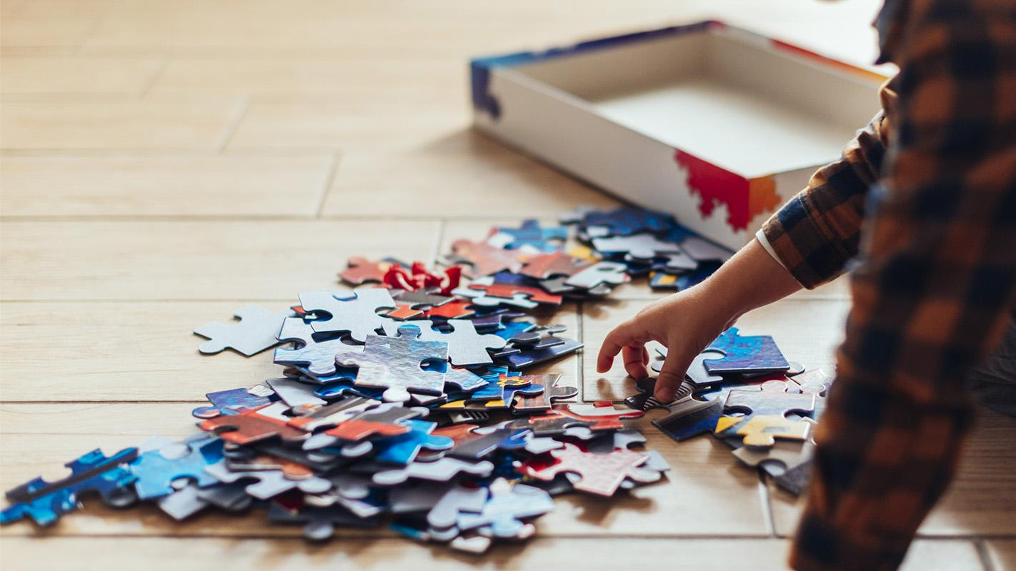
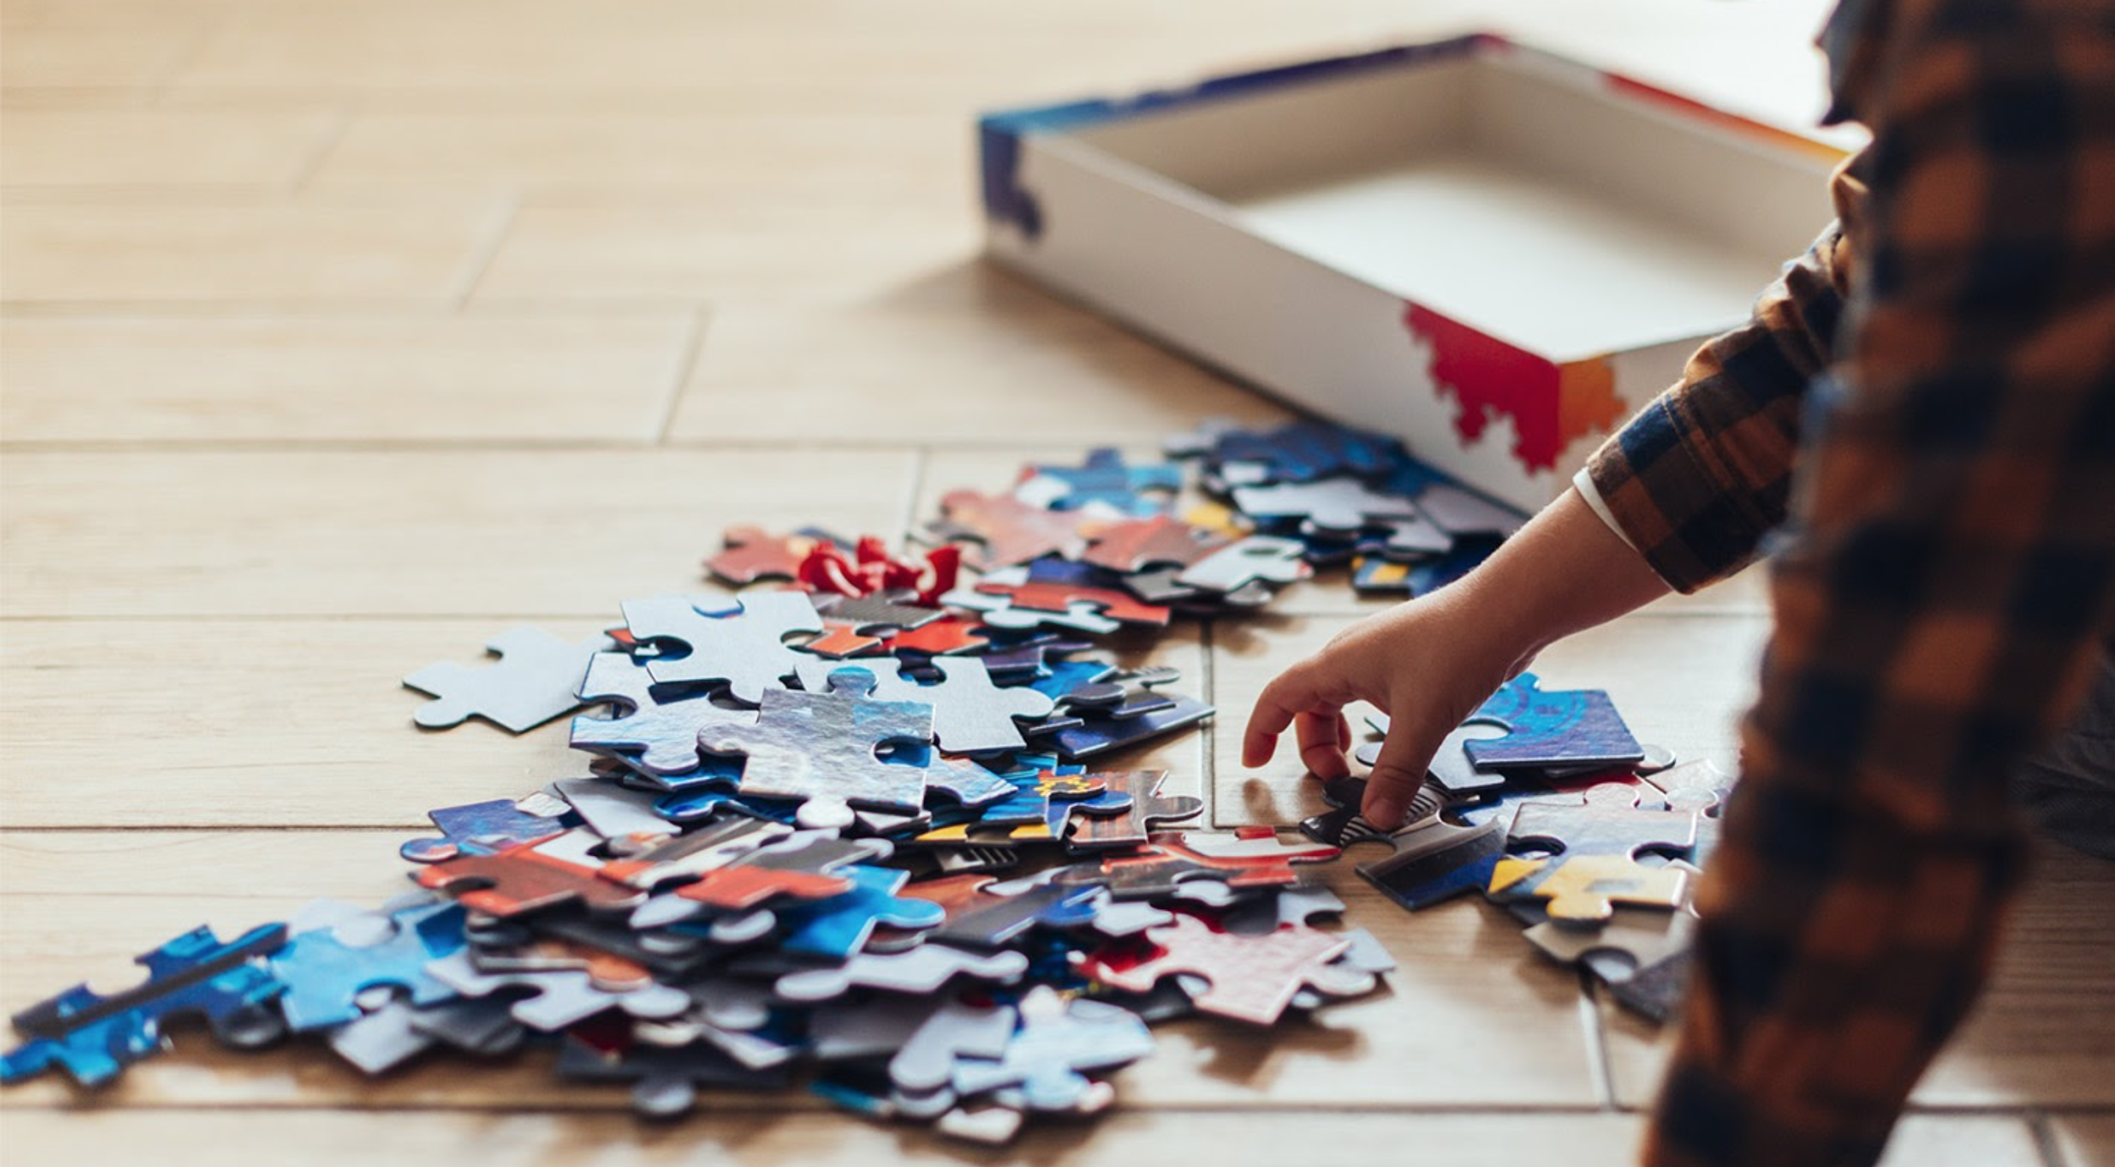
SLIDING WINDOW SPLIT

Slide 3
PUZZLE SLIDESHOW
Here is where your presentation begins

Slide 4
CONTENT OF THIS TEMPLATE
Here’s what you’ll find in this Slidesgo template:
A slide structure based on a multi-purpose presentation for education, which you can easily adapt to your needs. For more info on how to edit the template, please visit Slidesgo School or read our FAQs.
An assortment of pictures and illustrations that are suitable for use in the presentation can be found in the two alternative resources slides.
A thanks slide, which you must keep so that proper credits for our design are given.
A resources slide, where you’ll find links to all the elements used in the template.
Instructions for use.
Final slides with:
The fonts and colors used in the template.
A selection of illustrations. You can also customize and animate them as you wish with the online editor. Visit Stories by Freepik to find more.
More infographic resources, whose size and color can be edited.
Sets of customizable icons of the following themes: general, business, avatar, creative process, education, help & support, medical, nature, performing arts, SEO & marketing, and teamwork.
You can delete this slide when you’re done editing the presentation.

Slide 5
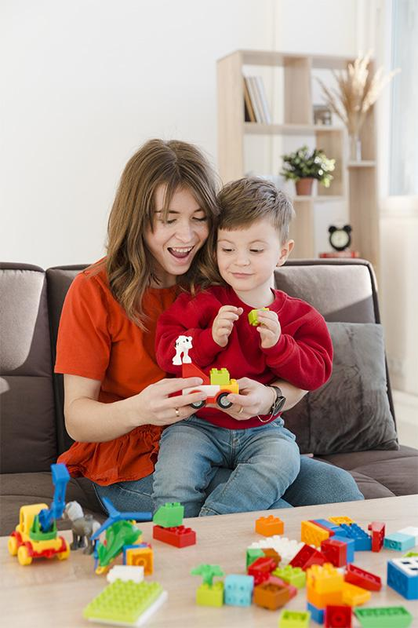
WHOA!
This could be the part of the presentation where you can introduce yourself, write your email…

Slide 6
“THIS IS A QUOTE, WORDS FULL OF WISDOM THAT SOMEONE IMPORTANT SAID.”
—SOMEONE FAMOUS

Slide 7
TABLE OF CONTENTS
INTRODUCTION
PRESENTATION
Here you could describe the topic of the section
Here you could describe the topic of the section
ANALYSIS
CONCLUSION
Here you could describe the topic of the section
Here you could describe the topic of the section

Slide 8
COMPANY
You can enter a subtitle here if you need it

Slide 9
THE SLIDE TITLE GOES HERE!
Do you know what helps you make your point clear? List like this one:
They’re simple
You can organize your ideas clearly
You’ll never forget to buy milk!
And the most important thing: the audience won’t miss the point of your presentation

Slide 10
AWESOME WORDS
Because words are great for catching your audience’s attention

Slide 11
WHAT ABOUT THESE TWO CONCEPTS
MERCURY
VENUS
It’s the closest planet to the Sun and the smallest one in the Solar System
Venus has a beautiful name and is the second planet from the Sun

Slide 12
YOU COULD USE THREE COLUMNS
VENUS
JUPITER
SATURN
Venus has a beautiful name and is the second planet from the Sun
Jupiter is a gas giant and the biggest planet in the Solar System
Saturn is a gas giant, composed mostly of hydrogen and helium

Slide 13

A PICTURE ALWAYS REINFORCES THE CONCEPT
Images reveal large amounts of data, so remember: use an image instead of a long text

Slide 14
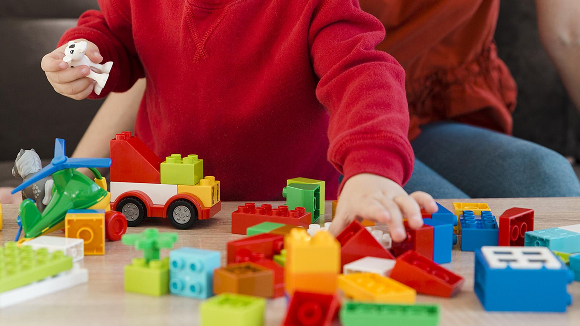
A PICTURE IS WORTH A
THOUSAND WORDS

Slide 15
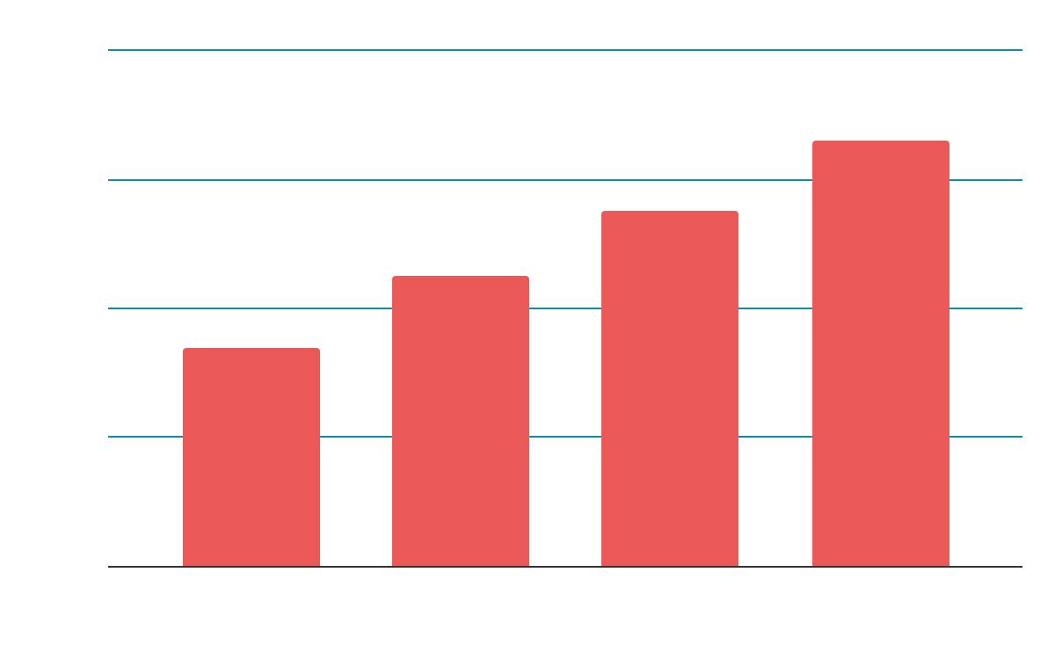
THIS IS A GRAPH
Despite being red, Mars is actually a cold place
If you want to modify this graph, click on it, follow the link, change the data and paste the new graph here

Slide 16
SOME ACTIVITIES YOU CAN DO
MERCURY
VENUS
MARS
Mercury is the closest planet to the Sun
Venus has a beautiful name, but it’s terribly hot
Despite being red, Mars is actually a cold place
JUPITER
SATURN
NEPTUNE
It’s the biggest planet in the Solar System
Saturn is the ringed one and a gas giant
Neptune is the farthest planet from the Sun

Slide 17
INFOGRAPHICS MAKE YOUR IDEA
UNDERSTANDABLE...
MERCURY
MARS
Mercury is the closest planet to the Sun
Despite being red, Mars is a cold place
JUPITER
SATURN
It’s the biggest planet in the Solar System
Saturn is the ringed one and a gas giant

Slide 18
...AND THE SAME GOES FOR TABLES
MARS
MERCURY
SATURN
DAY
DAY
DAY
Activity
Activity
Activity
Activity
Activity
Activity
Activity
Activity
Activity
RATE
RATE
RATE

Slide 19
ACTIVITY REWARDS
JUPITER | MERCURY | VENUS | MARS
1 | 1 | 1 | 1
2 | 1 | 3 | 1
1 | 3 | 1 | 2
1 | 4 | 1 | 1
STARS
ROCKETS

Slide 20
THIS IS A MAP
Mercury is the closest planet to the Sun
Venus has a beautiful name, but it’s terribly hot
Despite being red, Mars is actually a very cold place
Mercury is the closest planet to the Sun

Slide 21
A TIMELINE ALWAYS WORKS WELL
Mercury is the closest planet to the Sun
Despite being red, Mars is actually a cold place
DAY 1
DAY 3
Venus has a beautiful name, but it’s terribly hot
Neptune is the farthest planet from the Sun
DAY 2
DAY 4

Slide 22
4,498,300
BIG NUMBERS CATCH YOUR AUDIENCE’S ATTENTION

Slide 23
333,000.00
24h 37m 23s
386,000 km
earths is the Sun’s mass
is Jupiter’s rotation period
is the distance between Earth and the Moon

Slide 24
TYPES OF ACTIVITIES
35%
40%
25%
MERCURY
VENUS
MARS
Mercury is the closest planet to the Sun
Venus has a beautiful name, but it’s terribly hot
Despite being red, Mars is actually a cold place

Slide 25
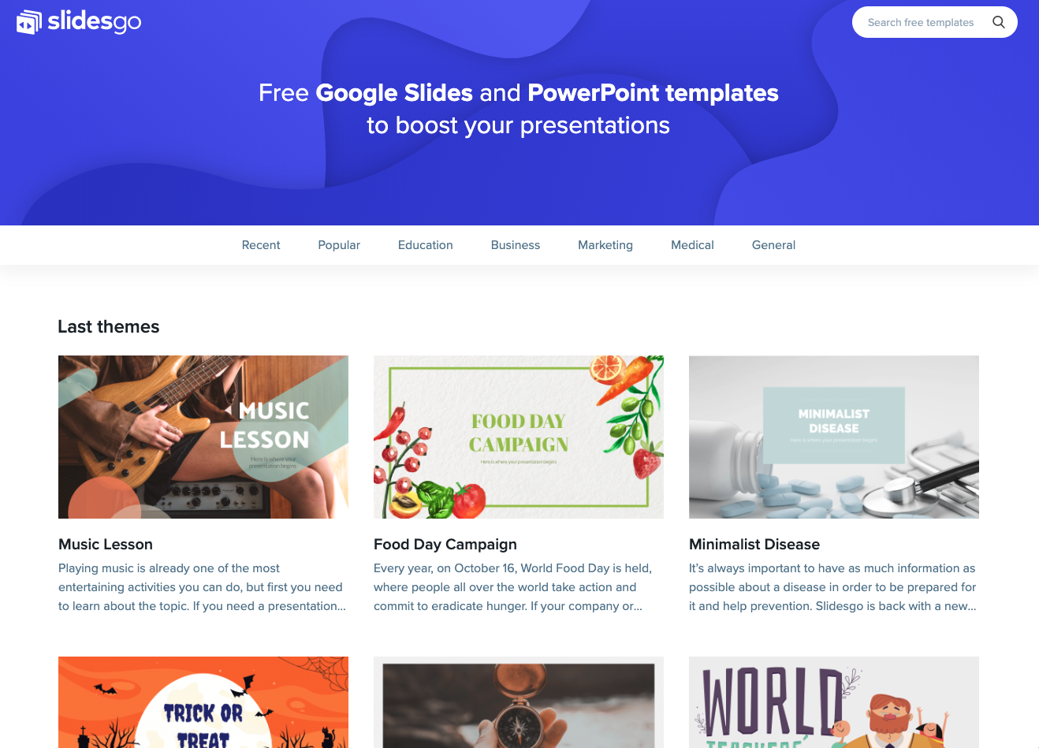
DESKTOP SOFTWARE
Venus has a beautiful name, but it’s terribly hot
You can replace the image on the screen with your own work

Slide 26
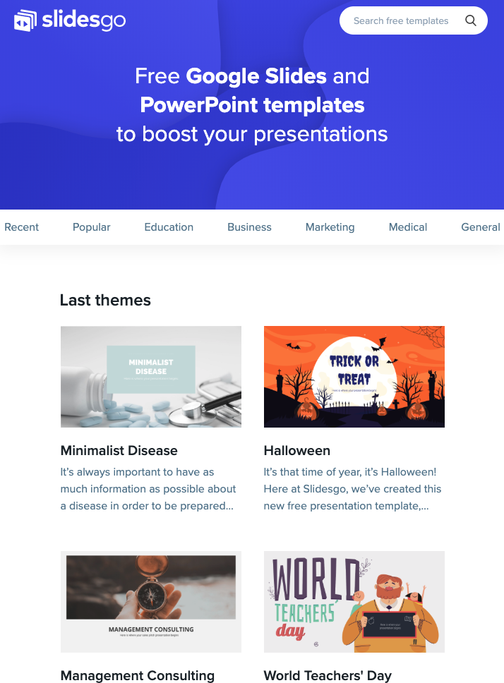
TABLET APP
Mercury is the closest planet to the Sun
You can replace the image on the screen with your own work

Slide 27
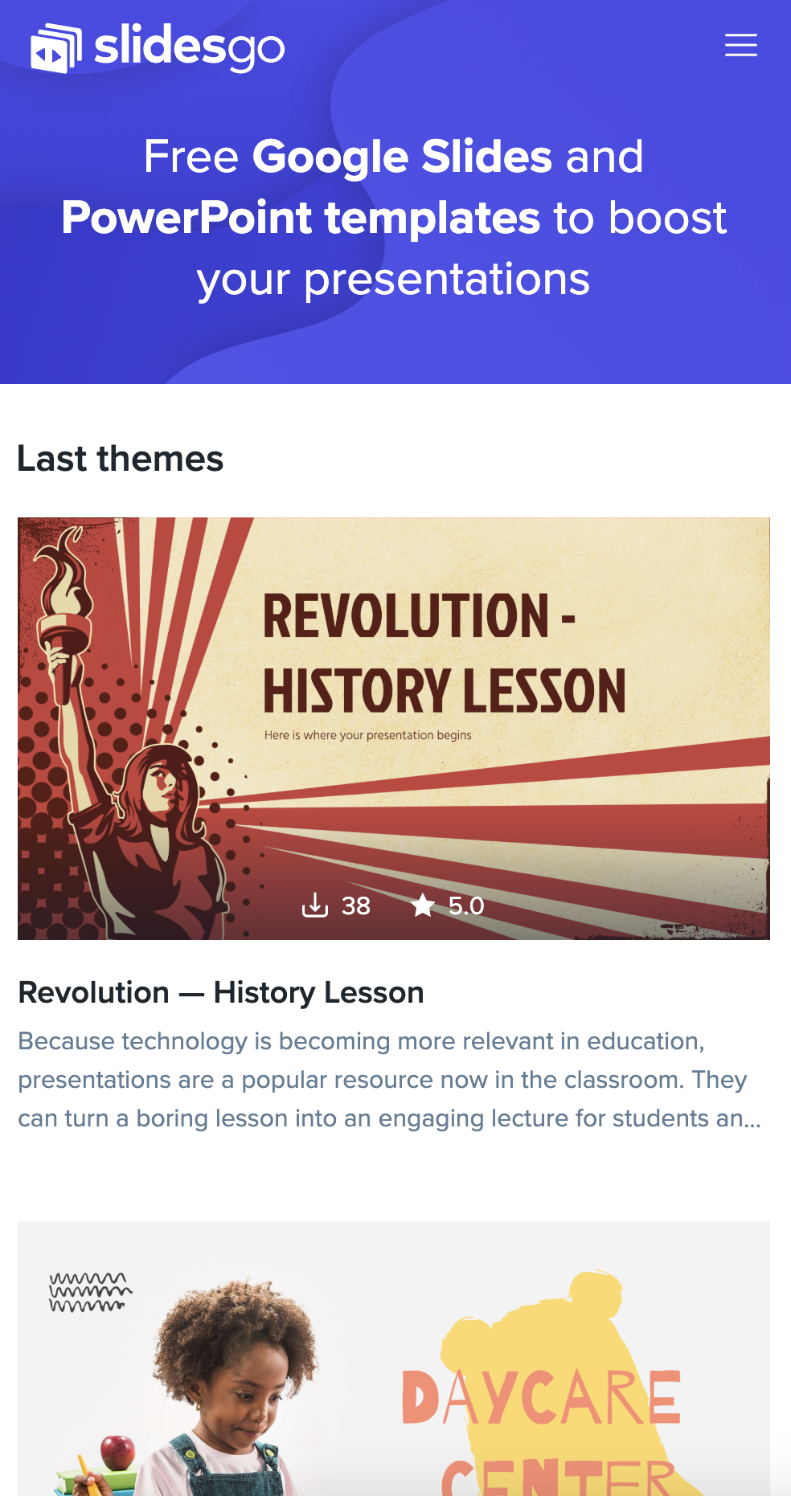
MOBILE WEB
Despite being red, Mars is actually a cold place
You can replace the image on the screen with your own work

Slide 28
THANKS!
Do you have any questions?
addyouremail@freepik.com
+91 620 421 838
yourcompany.com
Please keep this slide for attribution

Slide 29
ALTERNATIVE RESOURCES
VECTORS

Slide 30
ALTERNATIVE RESOURCES
IMAGES
Smiley mother watching son playing
Close-up kid with toys indoors
Boy playing with alphabet game
VECTORS
Flat business landing page template
People connecting puzzle pieces colorful background
Corporate teamwork landing page design
Pack of young people reading
People connecting puzzle pieces
Teamwork landing page with illustrated characters

Slide 31
RESOURCES
IMAGES
Smiley mother playing with her son
Close-up mom and son playing
Boy playing with alphabet game indoors
Kid playing with jigsaw
VECTORS
Colorful background people making puzzle together
Arrangement of people and objects university concept
People connecting puzzle pieces
Step infographic
Price banners in the form of puzzle for web
Young people giving high five
Flat geometric shapes wallpaper

Slide 32
Instructions for use
In order to use this template, you must credit Slidesgo by keeping the Thanks slide.
You are allowed to:
- Modify this template.
- Use it for both personal and commercial projects.
You are not allowed to:
- Sublicense, sell or rent any of Slidesgo Content (or a modified version of Slidesgo Content).
- Distribute Slidesgo Content unless it has been expressly authorized by Slidesgo.
- Include Slidesgo Content in an online or offline database or file.
- Offer Slidesgo templates (or modified versions of Slidesgo templates) for download.
- Acquire the copyright of Slidesgo Content.
For more information about editing slides, please read our FAQs or visit Slidesgo School:
https://slidesgo.com/faqs and https://slidesgo.com/slidesgo-school

Slide 33
Fonts & colors used
This presentation has been made using the following fonts:
Rubik
(https://fonts.google.com/specimen/Rubik)
#fab21e
#eb5858
#625676
#383a45
#e9b8bf
#d8a4af
#73c6cb
#088ea7
#d6ebe1
#fffffff

Slide 34





Stories by Freepik
Create your Story with our illustrated concepts. Choose the style you like the most, edit its colors, pick the background and layers you want to show and bring them to life with the animator panel! It will boost your presentation. Check out How it Works.
Pana
Amico
Bro
Rafiki
Cuate

Slide 35
Use our editable graphic resources...
You can easily resize these resources without losing quality. To change the color, just ungroup the resource and click on the object you want to change. Then, click on the paint bucket and select the color you want. Group the resource again when you’re done. You can also look for more infographics on Slidesgo.

Slide 38
JANUARY
FEBRUARY
MARCH
APRIL
MAY
JUNE
PHASE 1
Task 1
Task 2
PHASE 2
Task 1
Task 2
JANUARY
FEBRUARY
MARCH
APRIL
PHASE 1
Task 1
Task 2

Slide 41
...and our sets of editable icons
You can resize these icons without losing quality.
You can change the stroke and fill color; just select the icon and click on the paint bucket/pen.
In Google Slides, you can also use Flaticon’s extension, allowing you to customize and add even more icons.

Slide 42
Educational Icons
Medical Icons

Slide 43
Business Icons
Teamwork Icons

Slide 44
Help & Support Icons
Avatar Icons

Slide 45
Creative Process Icons
Performing Arts Icons

Slide 46
Nature Icons

Slide 47
SEO & Marketing Icons

Slide 48


